Slide 1
Climate Change
Can Data Science Prove its Existence?

Slide 2
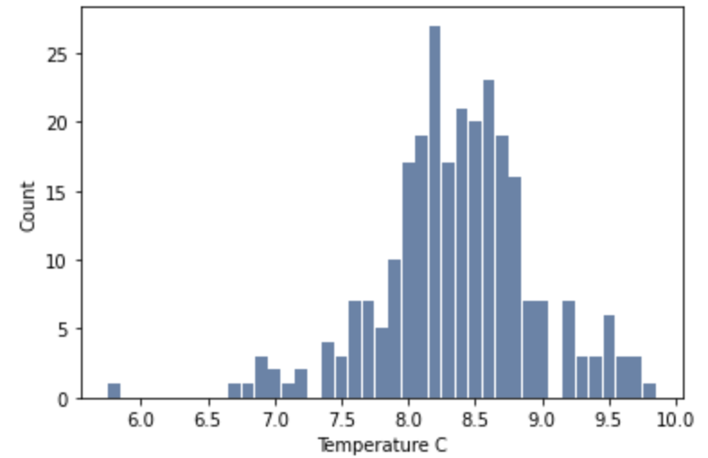
LandAverageTemperature
This variable represents that average temperature that has been observed globally each month since 1750.
It will be averaged over each year to convert it into a yearly average instead of a monthly average
Mean: 8.37 C
Median: 8.37 C
Std: 0.58 C
From the histogram there does not appear to be any outliers in the LandAverageTemperature variable.

Slide 3
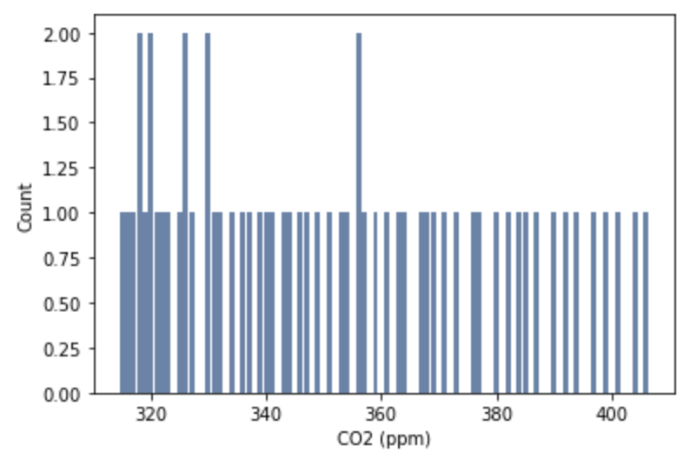
Seasonally Adjusted CO2 (ppm)
This variable represents that average temperature that has been observed globally each month since 1958.
It will be averaged over each year to convert it into a yearly average instead of a monthly average
Mean: 352.78 ppm
Median: 348.93 ppm
Std: 26.82 ppm
From the histogram there does not appear to be any outliers in the Seasonally Adjusted CO2 (ppm) variable.

Slide 4
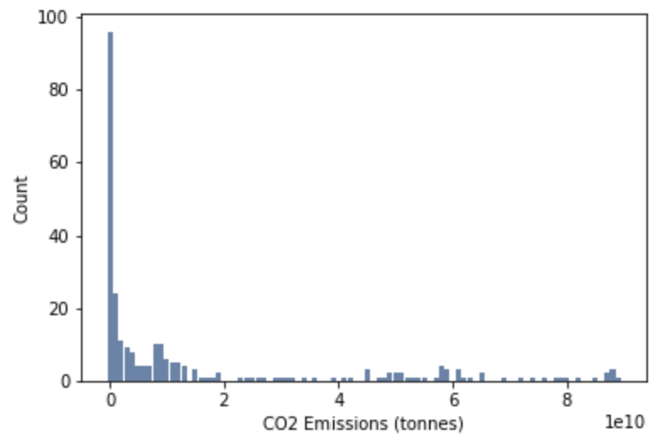
Annual CO₂ emissions (tonnes )
This variable is the total tonnes of CO2 that is emitted into the atmosphere each year by different countries since 1751
The total global emissions will be calculated by summing all the countries for a given year
Mean: 15,077,558,446 ppm
Median: 2,724,293,920 ppm
Std: 23,887,325,178 ppm
From the histogram there does not appear to be any outliers in the Annual CO₂ emissions (tonnes) variable.

Slide 5
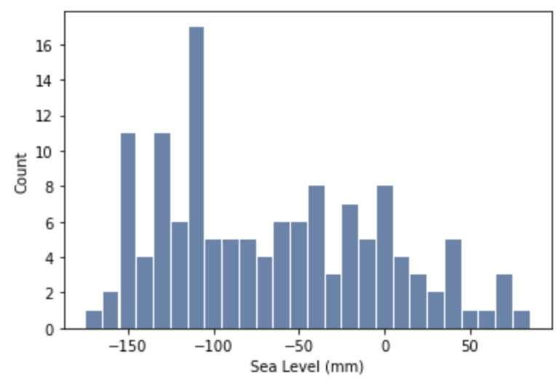
GMSL (Global Mean Sea Level)
GMSL is the global mean sea level represented as a difference in millimeters from the 1983 average
The total global emissions will be calculated by summing all the countries for a given year
Mean: -66.08 mm
Median: -76.11 mm
Std: 62.70 mm
From the histogram there does not appear to be any outliers in the GMSL variable.

Slide 6
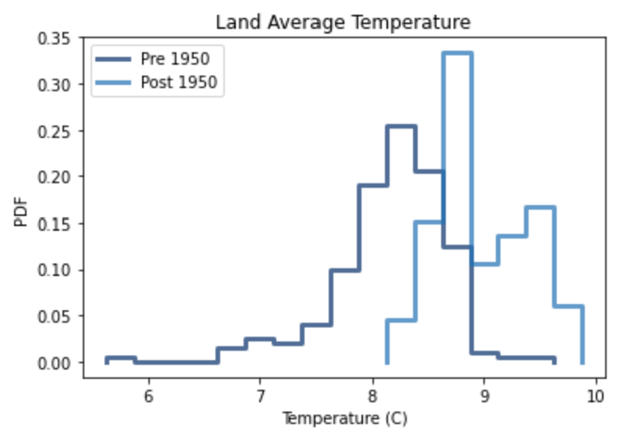
Average Temperature Pre and Post 1950
From the PDF graph it is very clear that the average land temperature after 1950 is consistently higher than before 1950.
This trend does not confirm the cause of a rise in global temperatures but it does confirm that the temperatures in the past few decades have been significantly higher than prior to 1950.

Slide 7
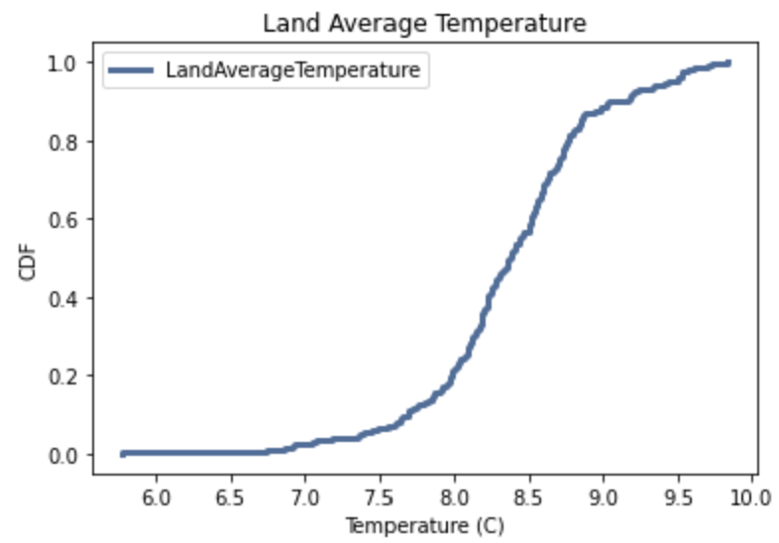
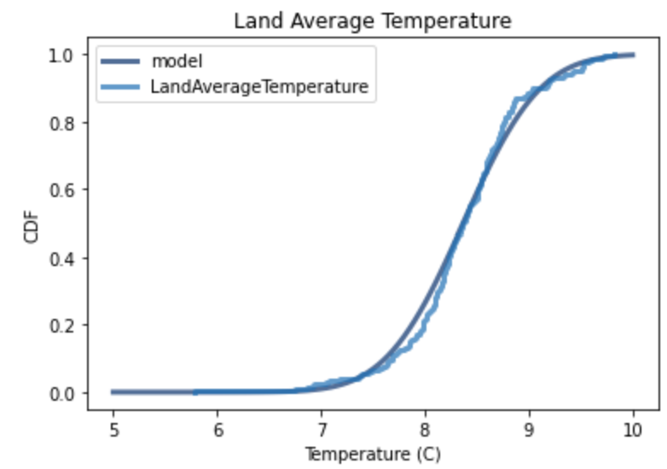
Cumulative Distribution Function
At first glance the CDF seems to imply a fairly normal distribution of the average temperatures.
When a model is fitted to the curve however it can be seen that it is not a perfectly normal distribution. Temperatures just below the mean are higher than predicted by a normal distribution and lower just above the mean.

Slide 8
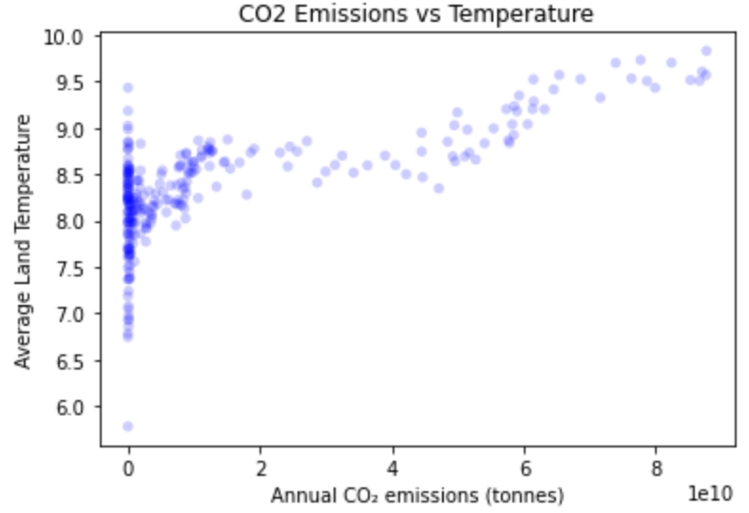
CO2 Emissions vs Average Temperature
The Pearson correlation factor is 0.70
The Spearman correlation factor is 0.62
While these two factors show a high correlation between CO2 emissions and the average temperature rising around the globe it does not imply causation.
When paired with scientific research is becomes indisputable that humans are having a direct effect on the rise in temperatures across the globe.

Slide 9
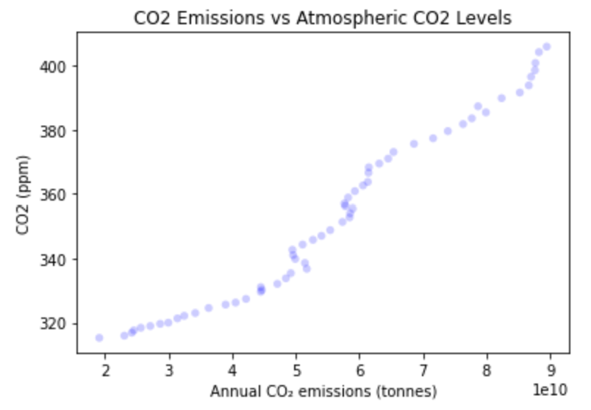
CO2 Emissions vs Atmospheric CO2 Levels
The Pearson correlation factor is 0.98
The Spearman correlation factor is 1.00
These two factors have an extremely high correlation. Given that the annual CO2 emissions are being put into the atmosphere it is very easy to draw a line between the two and assume that this is a causation effect at work.

Slide 10
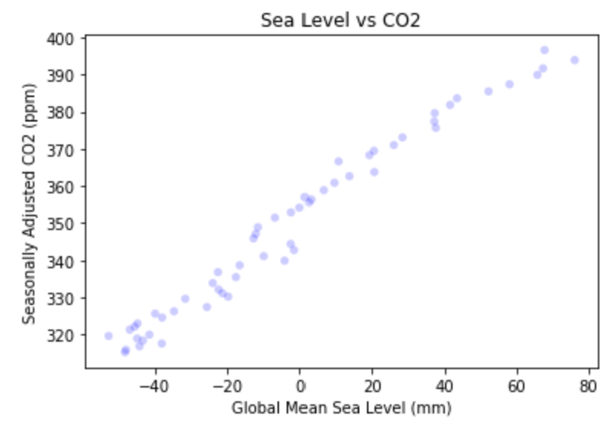
Atmospheric CO2 vs. Global Mean Sea Level
The Pearson correlation factor is 0.99
The Spearman correlation factor is 0.99
The sea level and the amount of CO2 in the atmosphere have a extremely high correlation. As with the previous slide this does not imply causation but science has shown that the rise in CO2 in the atmosphere has a direct impact on the rising sea levels.
To ensure that this correlation factor was not a fluke, a correlation test was done and the P-Value was 0.0 after one thousand iterations.

Slide 11
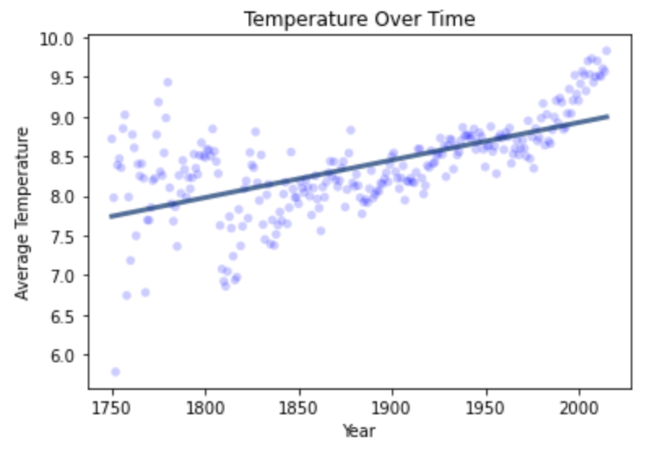
Average Global Temperature Over Time
A linear model was fitted to the global average land temperature and it can be seen that it was rising at a fairly linear rate from 1750 – 2000. Since then the rise in temperature has increased passed the initial trend.

Slide 12
References
Data for this analysis was obtained from the following resources,
https://www.kaggle.com/datasets/ucsandiego/carbon-dioxide
https://www.kaggle.com/datasets/yoannboyere/co2-ghg-emissionsdata
https://www.kaggle.com/datasets/somesh24/sea-level-change
https://www.kaggle.com/datasets/berkeleyearth/climate-change-earth-surface-temperaturedata

